Slide 1
Bacterial Special Pathogens Branch One Health Environmental Research
William Bower, MD
Bacterial Special Pathogens Branch
Division of High Consequence Pathogens and Pathology
ARS Geospatial and Environmental Epidemiology Research Unit (GEERU) Planning Workshop—May 21-22, 2024

Slide 2
Presentation Overview
Melioidosis (Burkholderia pseudomallei) Cluster Investigation— Mississippi Gulf Coast, 2022 & 2023
Severe inhalation anthrax-like illness from B. tropicus containing the pXO1 plasmid in a welder — Mississippi and Louisiana, 2020

Slide 3
Melioidosis (Burkholderia pseudomallei) Cluster Investigation— Mississippi Gulf Coast, 2022 & 2023
3

Slide 4

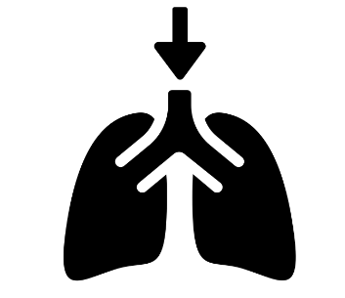
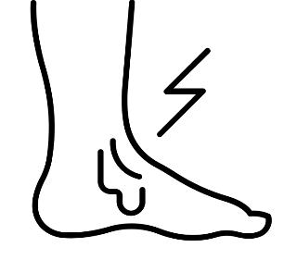
Modes of transmission and incubation period
Routes of transmission: Direct contact with B. pseudomallei-contaminated soil or water via:
Incubation period: 1-21 days post exposure (median 4 days)
In ~5% of cases, infection can be activated months to years after exposure (latent reactivated infection)
Percutaneous inoculation
Inhalation
Ingestion
Notes:
Person to person transmission is extremely rare and has only been documented twice. For the majority of cases, symptoms occur 1-21 days from exposure. With a high inoculum, symptoms can develop in just a few hours of exposure. In about 5% of cases, symptoms can develop well past this 21-day window, months to years following exposure and are classified as latent-activated infections.
You may have heard of the …..
*In the U.S. we have seen melioidosis in Vietnam veterans who were exposed to b pseudomallei in the environment during the war in Vietnam and develop melioidosis many decades later.

Slide 5
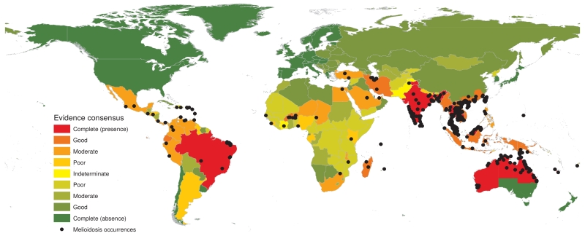
Melioidosis is endemic to subtropical and tropical regions worldwide where B. pseudomallei is found naturally in the environment
Limmathurotsakul, D., et al., Predicted global distribution of Burkholderia pseudomallei and burden of melioidosis. Nature Microbiology, 2016. 1(1): p. 15008.
Notes:
Melioidosis is endemic to subtropical and tropical regions worldwide where B. pseudomallei is found naturally in the environment, in soil and fresh water.
Map:
Global evidence consensus and geographic locations of occurrence data from 1910 to 2014 Country coloring is based on evidence-based consensus with green representing a complete consensus on absence of B. pseudomallei and red a complete consensus on presence of B. pseudomallei. Black dots represent geo-located records of melioidosis cases or presence of B. pseudomallei.

Slide 6
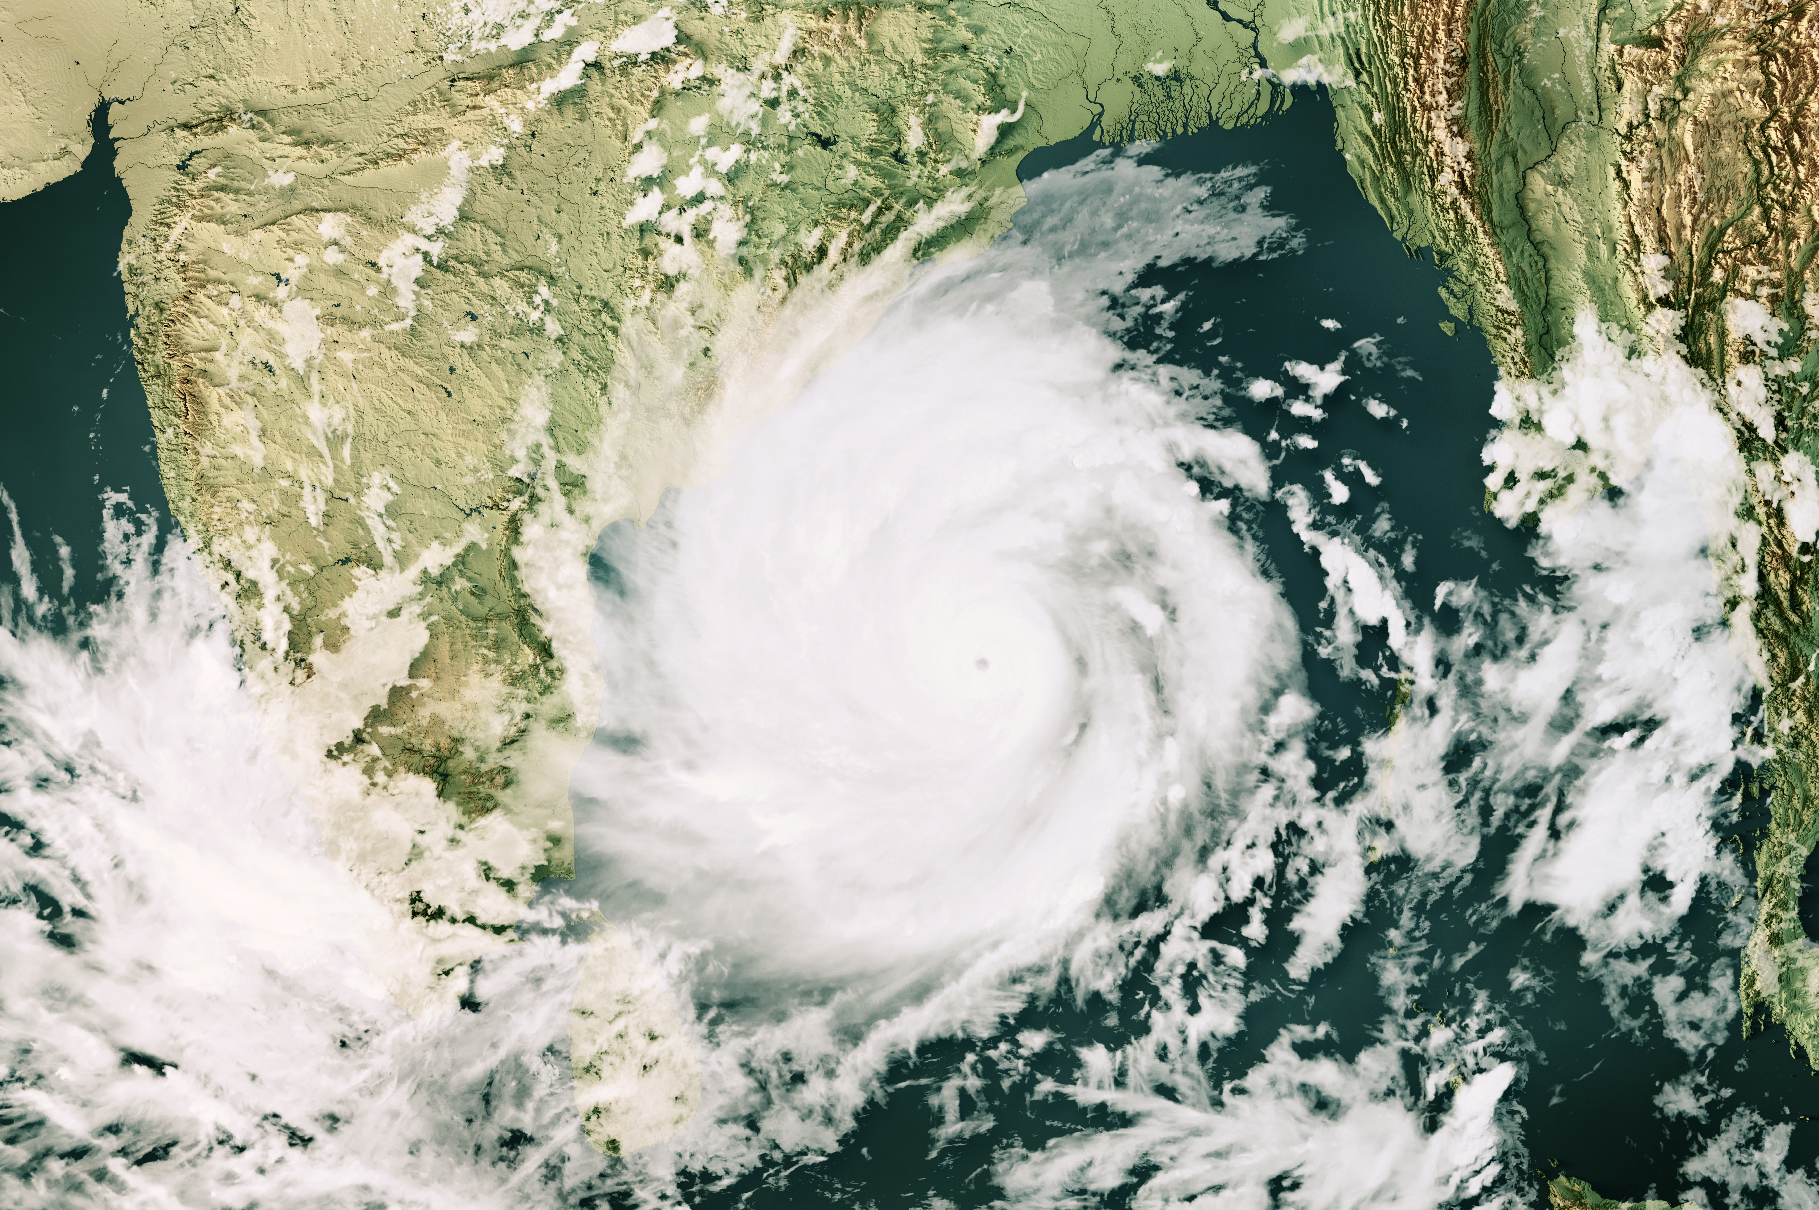
Cases have been associated with severe weather events and periods of heavy rain
Notes:
In endemic areas, melioidosis cases have been associated with severe weather vents and periods of heavy rain
Routes of exposure, incubation period

Slide 7
Evolving melioidosis epidemiology in the U.S.
*likely or confirmed domestic exposure based on genomic and epi data
Notes:
In the United States, Melioidosis is rare, with approximately 12 cases reported annually to the U.S. Centers for Disease Control and Prevention (CDC) that are predominately associated with travel to melioidosis-endemic regions. We have seen an increasing number of cases over the past 5 years or so, with an increasing proportion of non-travel associated cases – that is cases that had no travel history to an endemic area.

Slide 8
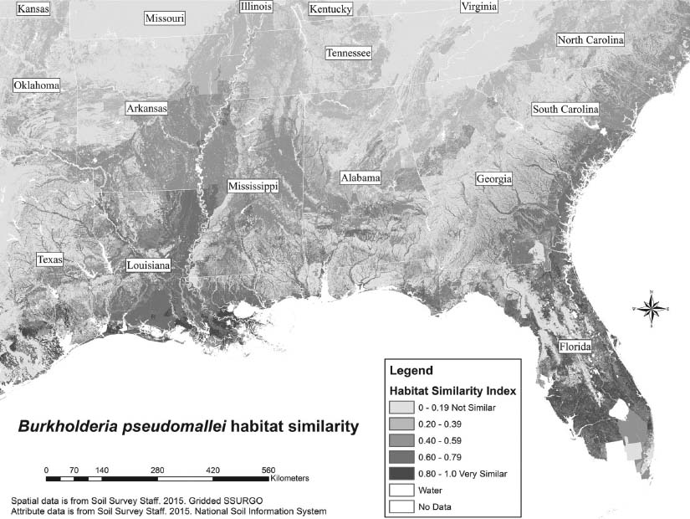
Parts of the southern U.S. have been predicted to be suitable for B. pseudomallei
Portacci K., AP Rooney, and R Dobos. Assessing the potential for Burkholderia pseudomallei in the southeastern United States. J Am Vet Med Assoc. 2017. 250(2): p. 153-159. https://doi.org/10.2460/javma.250.2.153
Notes:
Environmental suitability modeling studies suggest that the soil and climate in parts of the southern U.S. are suitable for B. pseudomallei as demonstrated by the darker shaded areas along parts of coastal regions.

Slide 9
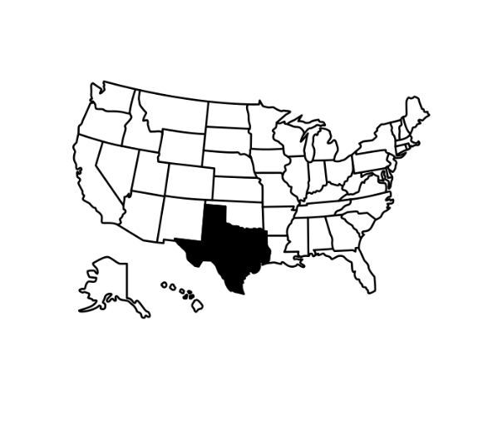
Locally-acquired melioidosis
2 people got sick from melioidosis in Atascosa County, Texas but no travel history to melioidosis endemic areas
The bacterium was never found in the local environment
https://wwwnc.cdc.gov/eid/article/26/6/19-0975_article
Notes:
In 2018, there was an investigation involving 2 patients in the south tx county of Atascosa county who has no recent travel hx and were infected by related western hem strains, despite extensive enviro sampling, the bacterium was never found but points to locally acquired melio.
----

Slide 10
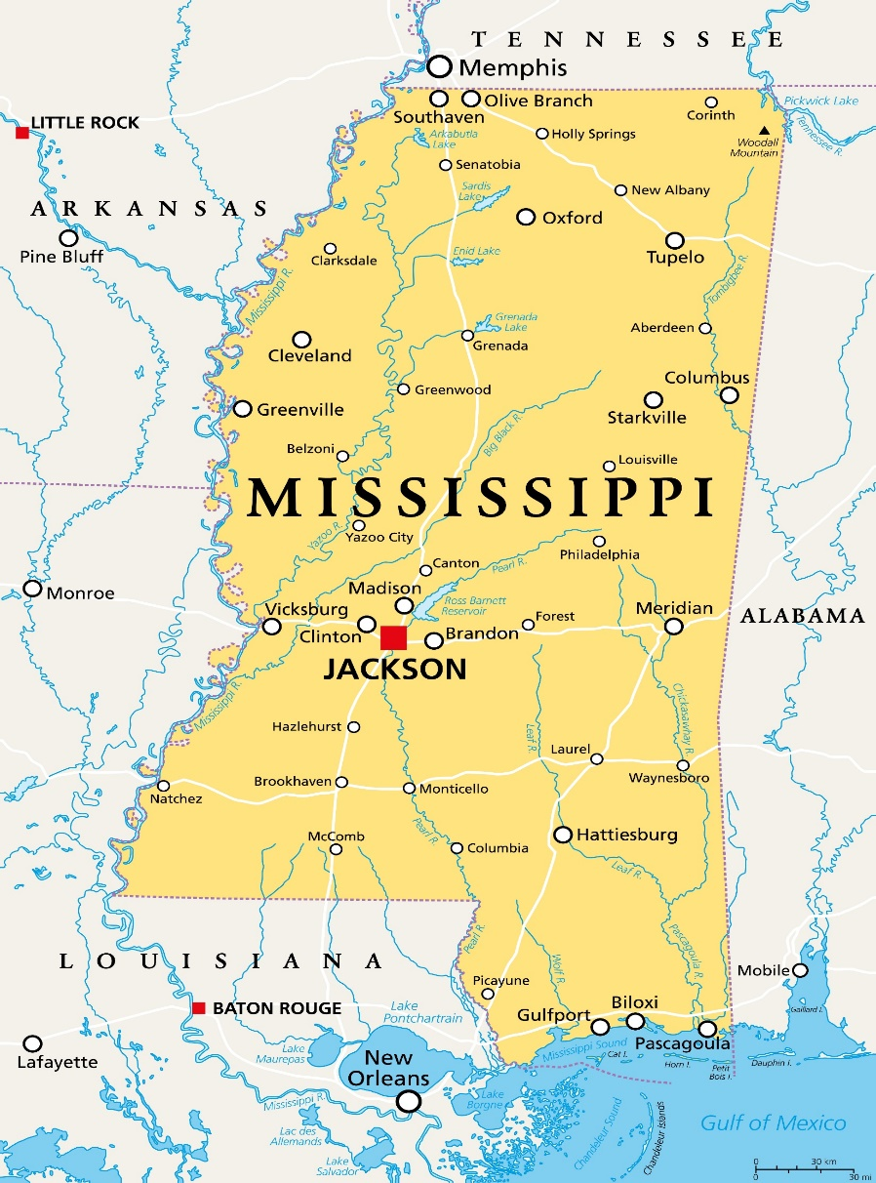

May 2, 2022
CDC was notified of a B. pseudomallei positive blood culture from a Mississippi patient
The strain that infected the patient was genetically identical to the strain that infected another Mississippi patient 2 years prior in July 2020
Both patients lived 7 miles apart in the same Mississippi Gulf Coast county
Notes:
These two patients both presented w/ sepsis and pneumonia

Slide 11
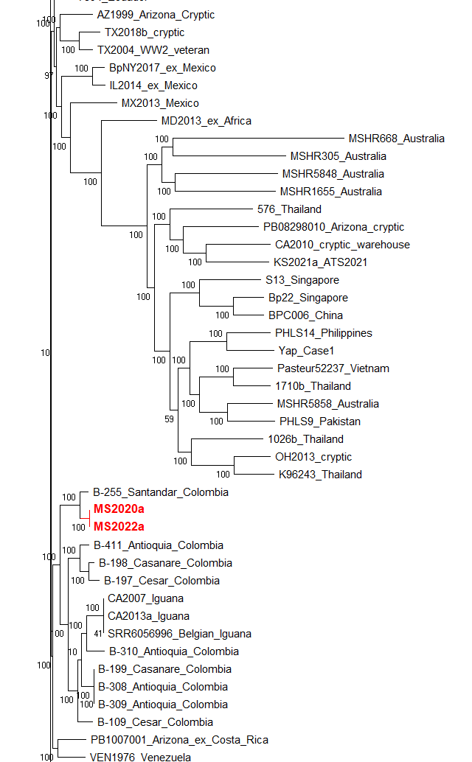


Western Hemisphere Origin
CLONAL & NOVEL STRAIN
Notes:
that groups closest to other examples from South America.

Slide 12
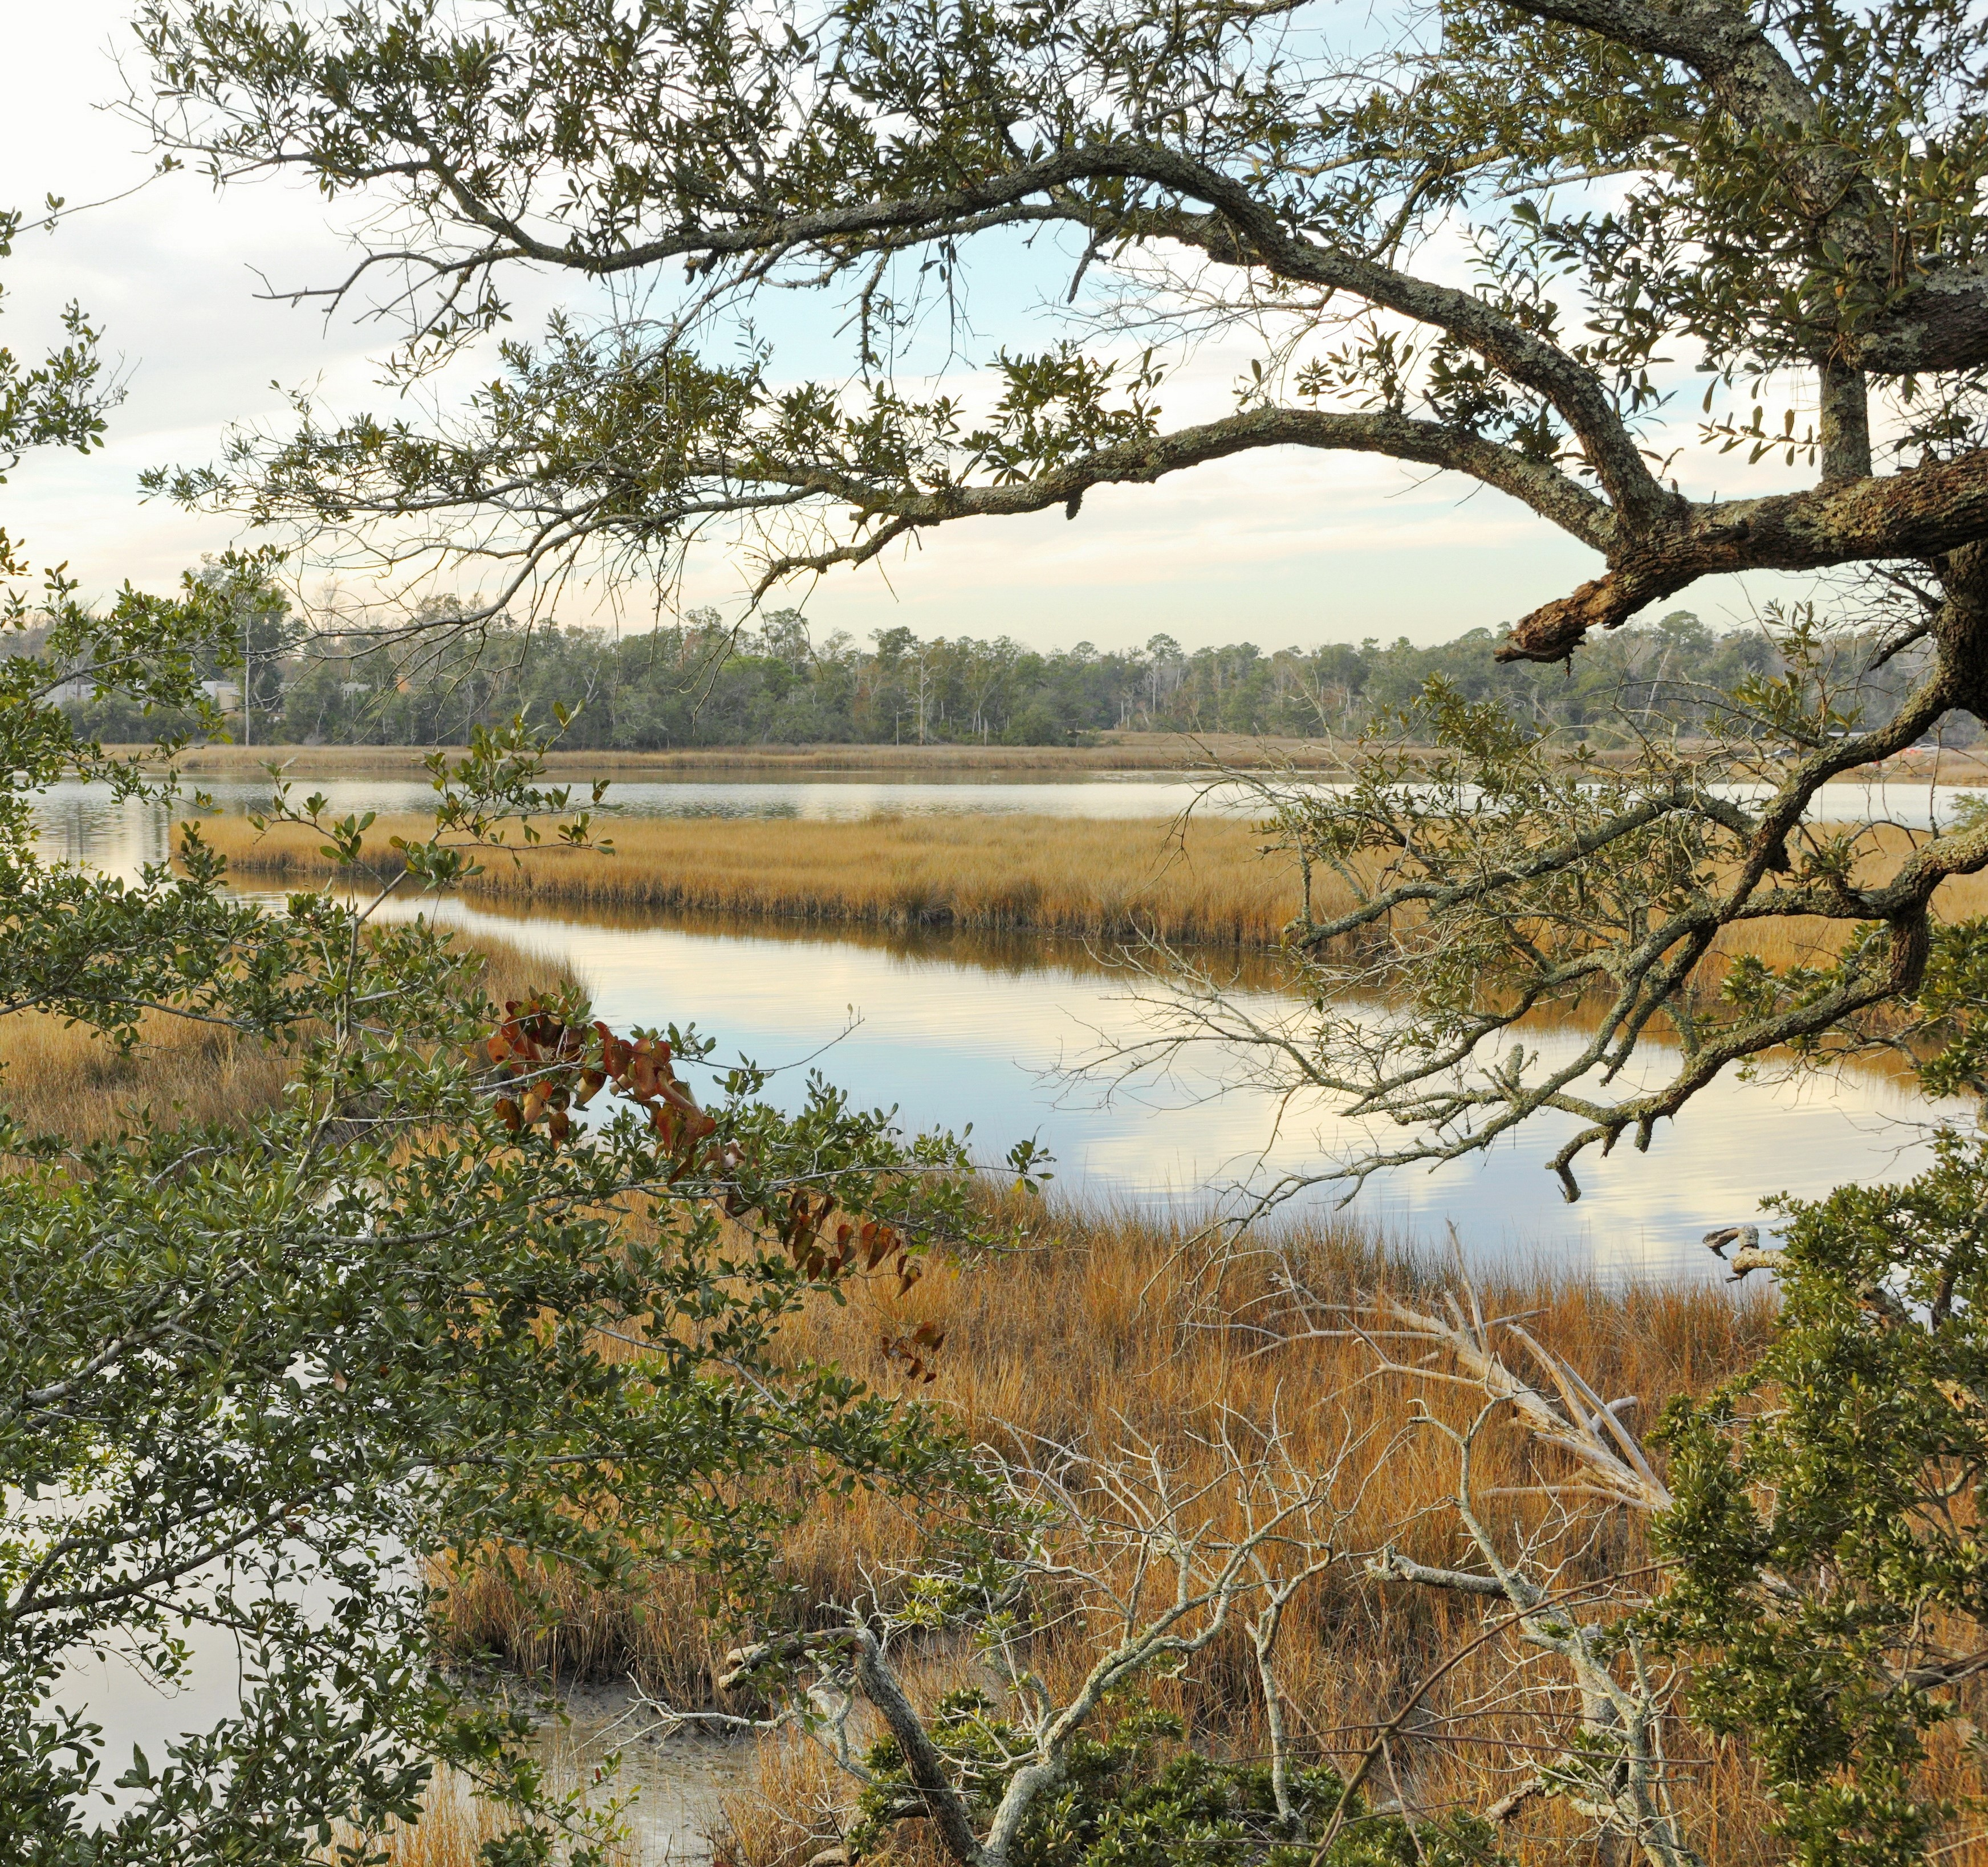
June 25-28, 2022
Epi-Aid 2022-014
Undetermined source of non-travel associated melioidosis cluster—Mississippi, 2022
Notes:
The Mississippi State Health Department requested an epi-aid and in late June, 2022, LLS fellow Maureen Ty and I traveled down to Mississippi to the county where these two patients lived.

Slide 13

79 environmental samples were collected across seven sites in the county
Soil
30 cm depth
Minimum of 20 grams (50mL conical)
Water
Fresh water sources (river, lake, pond)
Fire hydrant, storm drain (Patient 1)
Tap water (Patient 2)
Plant material
Dead fish
Notes:
We collected 79 environmental samples across 7 sites in the county including soil, collected at a depth of 30 cm, water from various sources, plant material and 1 dead fish.
Storage: Room temp away from UV light
Disinfect between each sample w/ 70% ethanol spray
*bulk water – grab samples – 1 L sterile bottles w/ sediment layer
Burk is a resident of the Rhizosphere or root microbiome
Depth: 30 cm depth
Volume: 20 grams, sterile 50mL conical
Storage: room temperature away from UV light

Slide 14
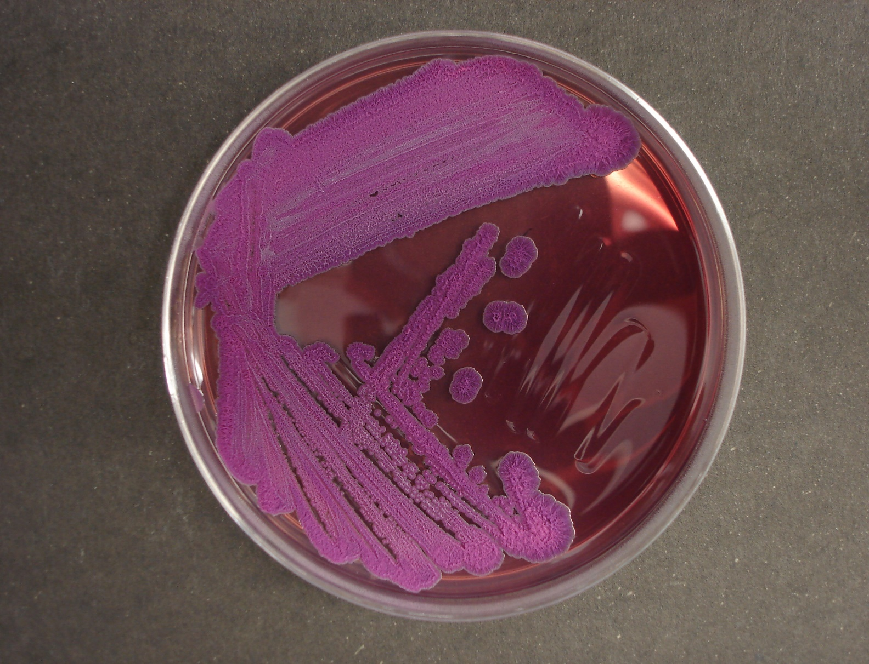
3 environmental samples test positive for B. pseudomallei
Notes:
To our surprise, 3 samples tested positive for b pseudomallei.

Slide 15
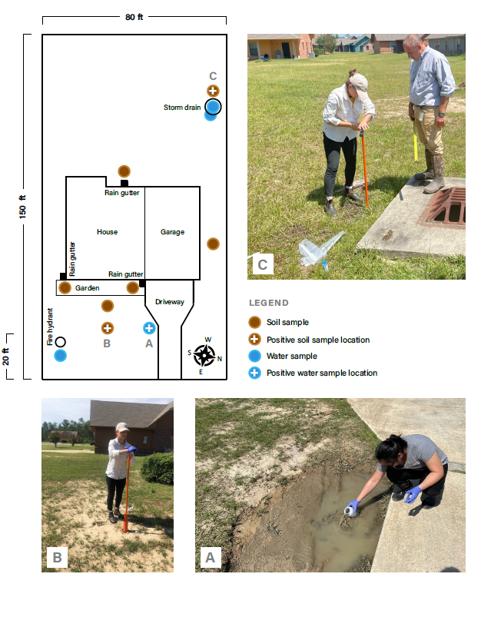
Patient 2 property

Slide 16
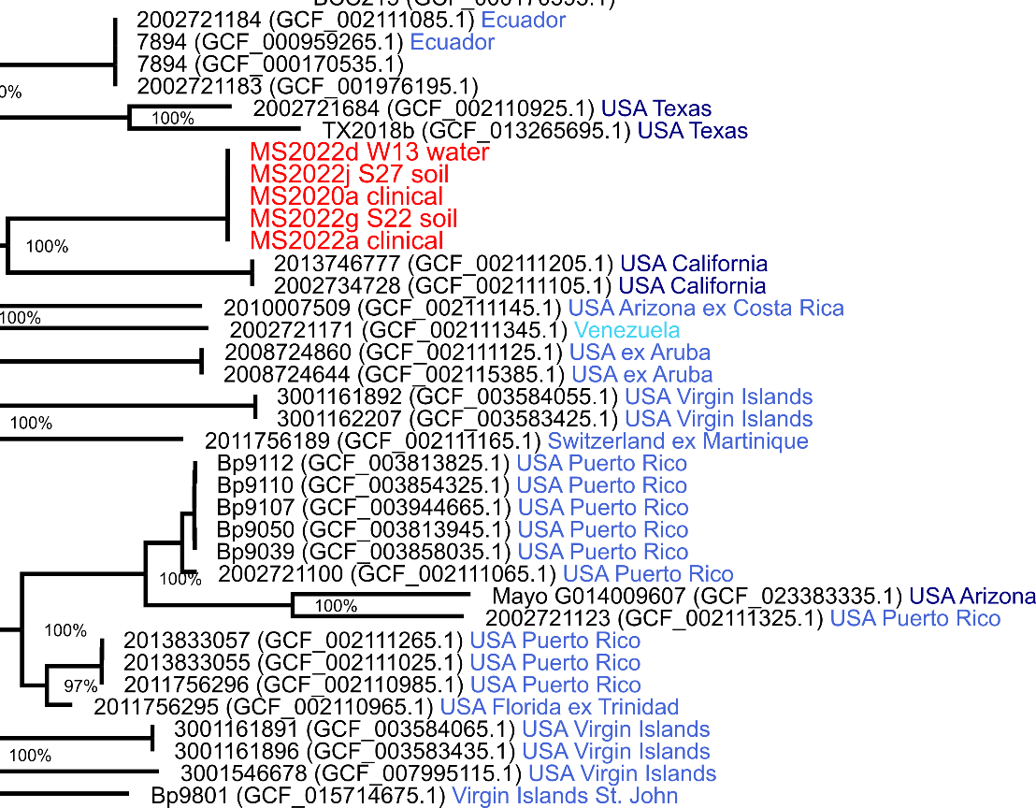
The environmental isolates are clonal to the clinical isolates from the two patients
CLONAL
Notes:
Not only were they positive but Whole genome sequencing revealed that these environmental isolates were clonal to the strain that infected the 2 patients. This finding suggests that both patients acquired melioidosis locally from the environment in MS.
All other samples were negative.

Slide 17

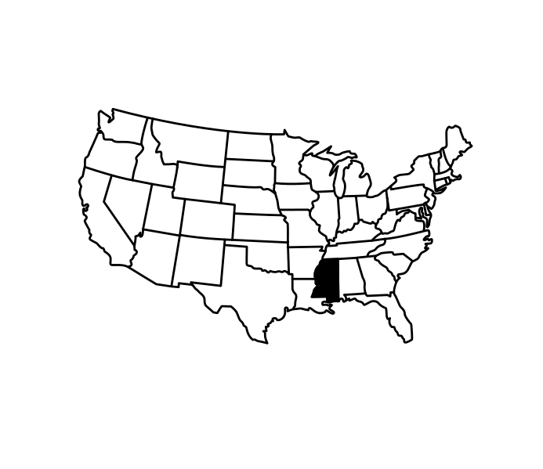
January 23, 2023 CDC was notified of Burkholderia pseudomallei positive blood and spinal abscess cultures from a Mississippi patient
Notes:
On January 27, 2023, CDC was notified by the Laboratory Response Network (LRN) and the Mississippi State Department of Health (MSDH) of another patient in MS confirmed to have melioidosis with no travel hx outside of the U.S.

Slide 18
March 20-24, 2023
Epi-Aid 2023-011:
Undetermined Exposure and Risk Factors for Melioidosis (Burkholderia pseudomallei) Cluster— Mississippi Gulf Coast, 2023
Notes:
To better understand the risk for melioidosis for people living in the effected region, an epi-aid was requested to conduct expanded enviro sampling, patient interviews, and serological testing of close contacts.
Before we arrived we underwent extensive planning w/ MS DoH, MS Mississippi State University, Coastal Marine Extension Program, EPA Gulf of Mexico Division (Dr. Troy Pierce) – we looks at maps together - focus though was still on new case patient property, - which was located close to river bank wetland area.

Slide 19
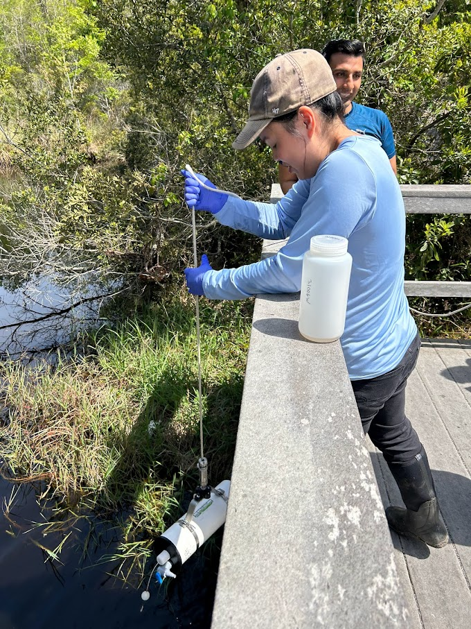
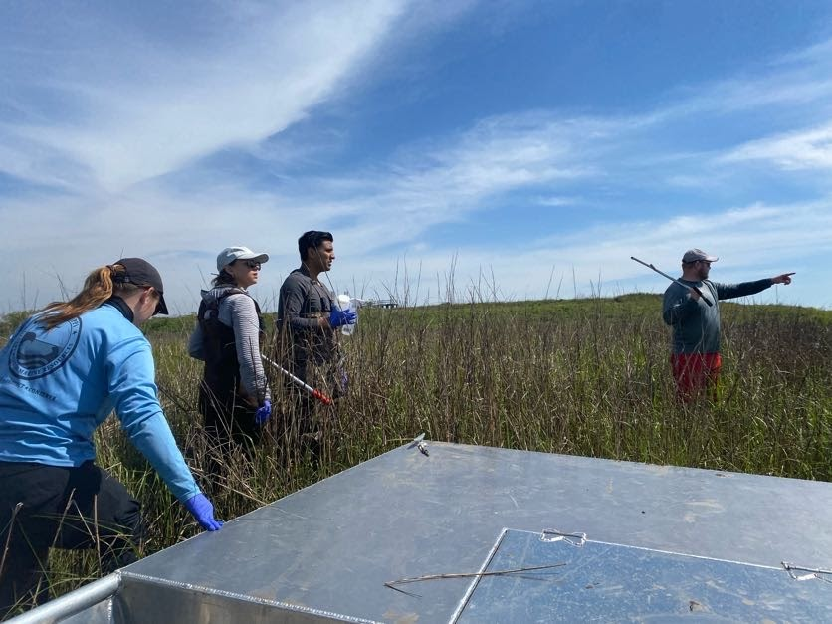
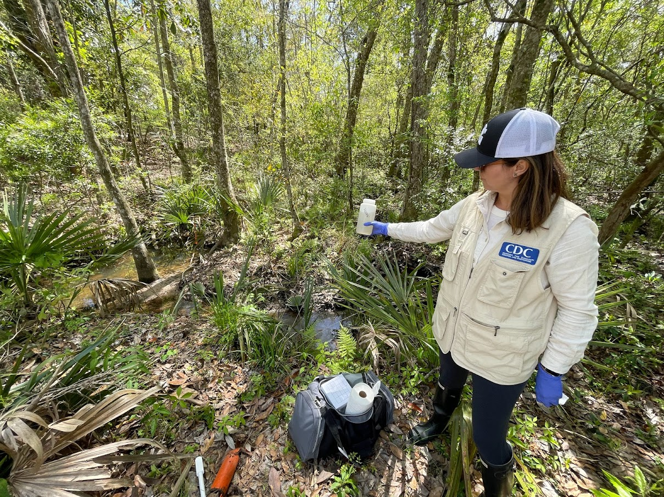
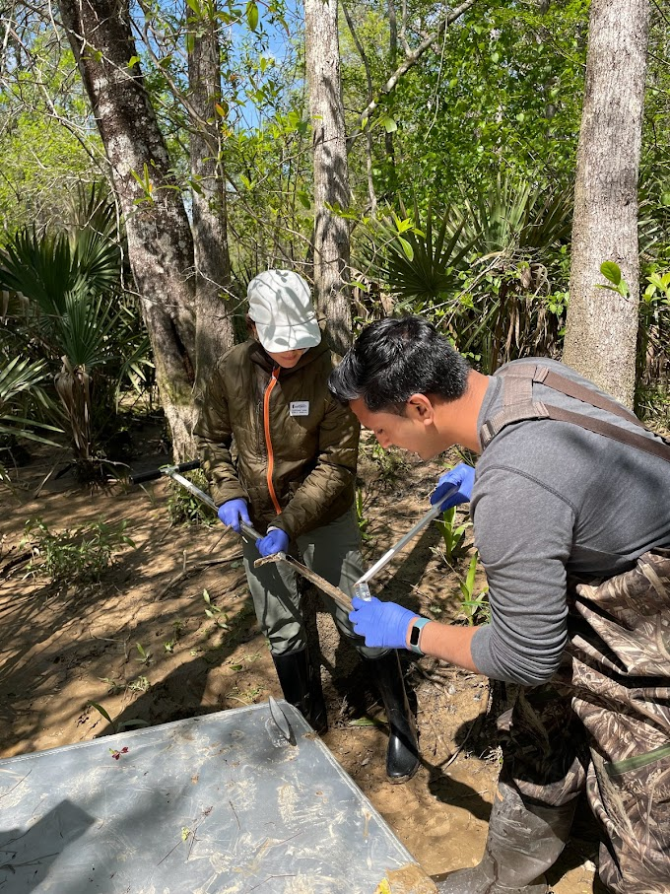
522 environmental samples were collected over 9 different sites in the MS Gulf Coastal county
Notes:
We successfully collect 522 environmental samples from this gulf coast MS county in partnership w/ MS DoH, EPA Gulf of Mexico Division, MS State University, Coastal Marine Extension program with an amazing team including EIS Officers Faisal minjal, Victoria Shelus, LLS fellow Maurrent Ty, and microbiologist Mindy Elrod.

Slide 20
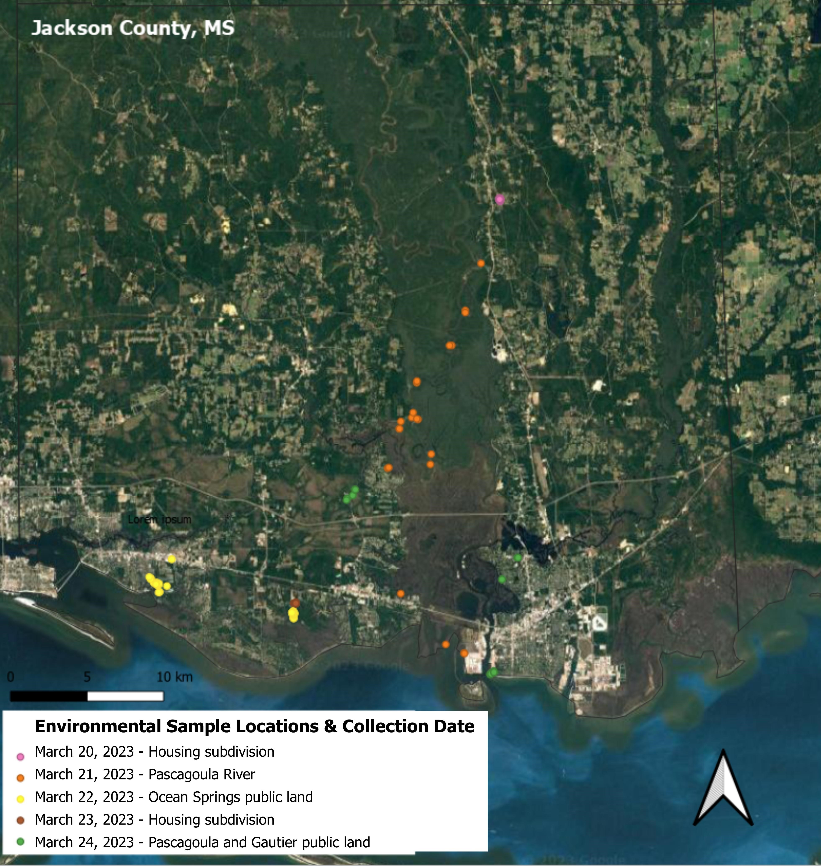

Slide 21
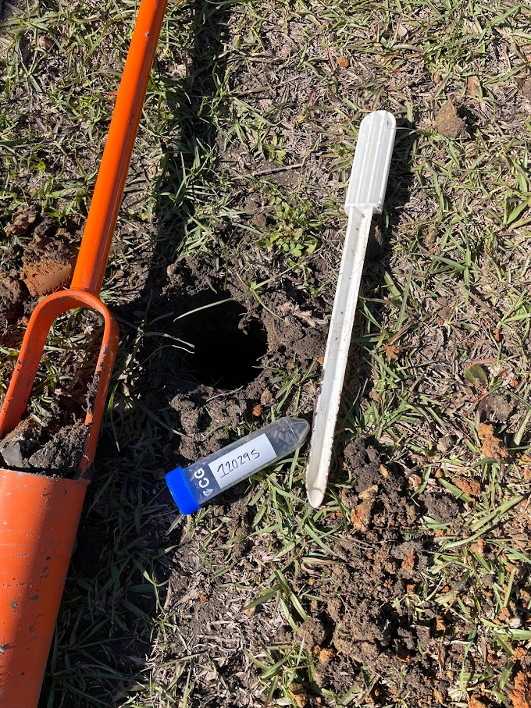
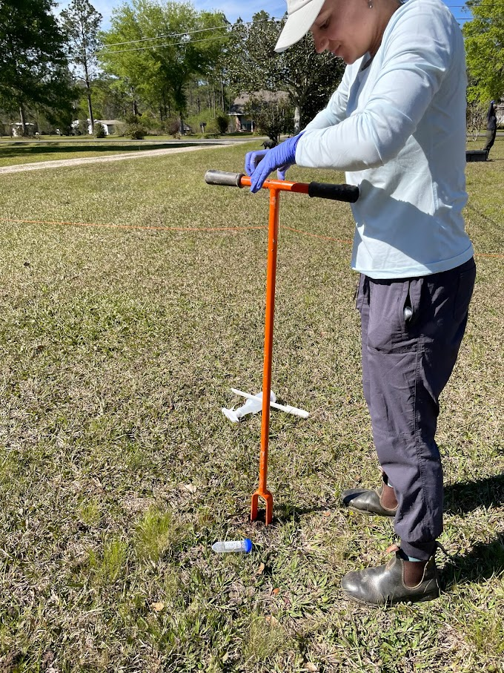
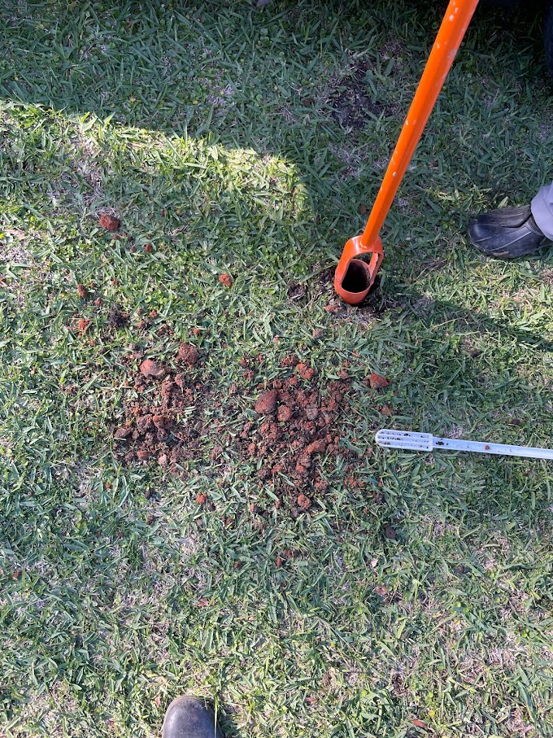
Fixed interval systematic grid method
Notes:
Fixed interval systematic grid method w/ each sample taken roughly y 5 meters apart
Soil: 114 (grid, front and back yard):
*11x`0 squares – 32ftx16 ft
including samples collected from on and around patient properties
Working in teams of 2:
Day 1
Total number of environmental samples: 156
Soil: 114 (grid, front and back yard): Water: 7 1 L (tap and well), 2 ultrafilters from pumphouse
Sediment: 1 (from pump house)
Swab: 32 (work gear from Ingall’s, shower and drains inside house)

Slide 22
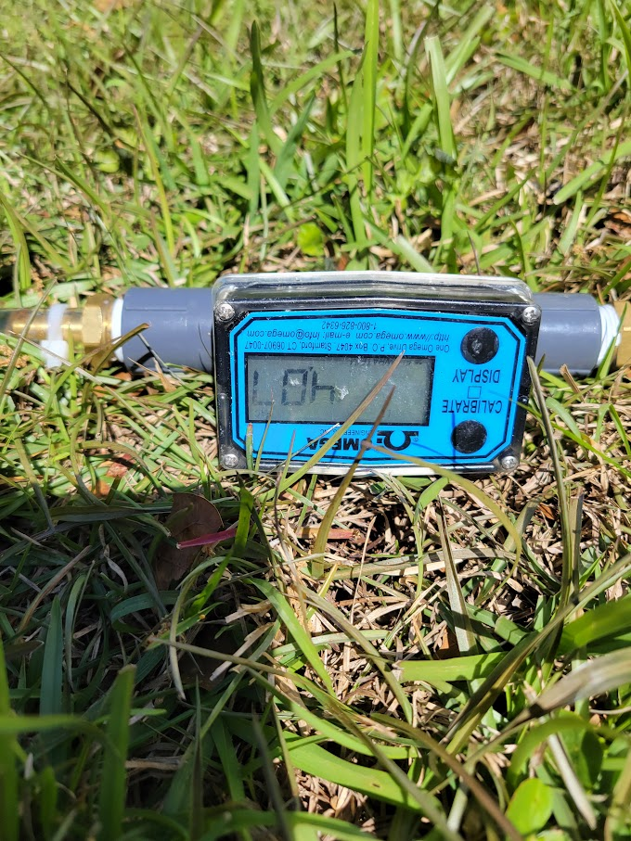
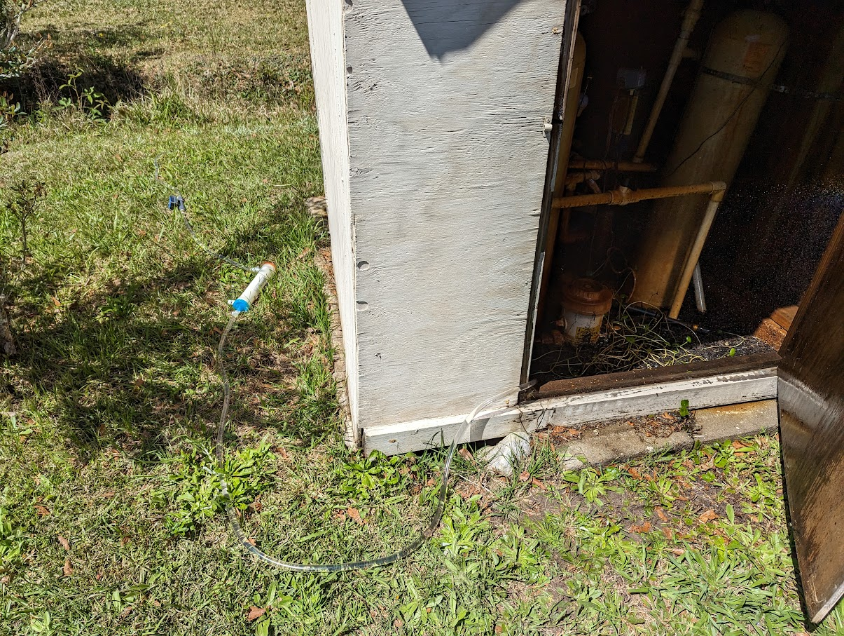
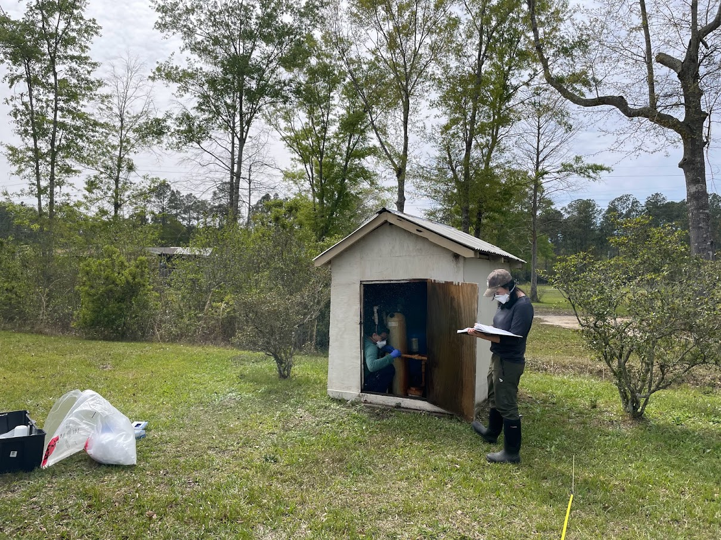
High Volume Water Filtration
Notes:
High volume water filtra2 ultrafilters – 240 L of water over 1 hour at 4L/min.
Sediment: 1 (from pump house)

Slide 23
2023 Case Property Results
154 total samples
21 Type-Three Secretion (TTS) PCR positives and 9 PCR indeterminate (>35 CT)
Positive samples were located alongside the front and side of the property near a ditch
No samples from the back yard were positive
No water or swabs were positive

Slide 24
Row 11
DITCH
FORREST
STREAM
Row 10
SHED
Row 9
Row 8
Row 7
HOUSE
Row 6
PUMP
HOUSE
DRIVEWAY
Row 5
Row 4
Row 3
Row 2
Row 1
STREET

Slide 25
2020 Case Property Results
111 total samples
64 TTS PCR positives and 3 PCR indeterminate (>35 Ct)
Positive samples were in the front and back yard
One water sample tested positive-a retention pond at the back of the property

Slide 26
Row 10
Row 9
Row 8
Row 7
HOUSE
GARAGE
NEIGHBORING PROPERTY
Row 6
DRIVEWAY
Row 5
Row 4
Row 3
Row 2
Row 1
9 8 7 6 5 4 3 2 1
STREET

Slide 27
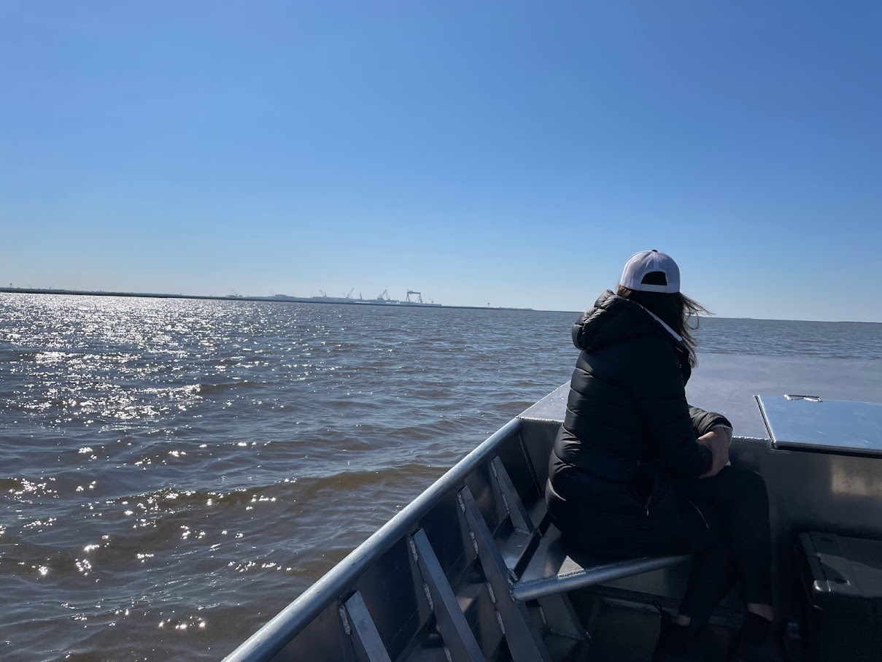
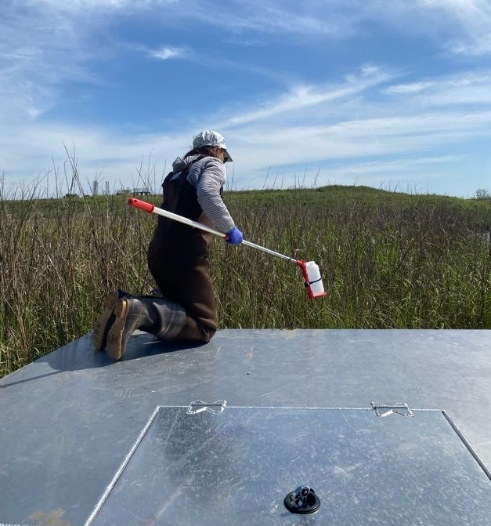
Sampling along the River
Notes:
Day 2: Pascagoula River Wetland Area
Date: 3/21/2023
Total number of samples: 59
22 soil
19 river bed sediment
18 river water
Every x miles*****
ph and Salinity were taken

Slide 28
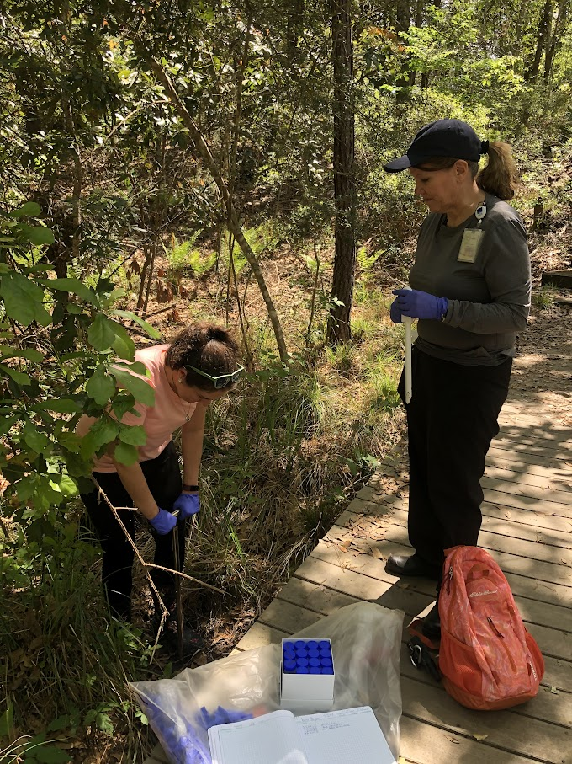
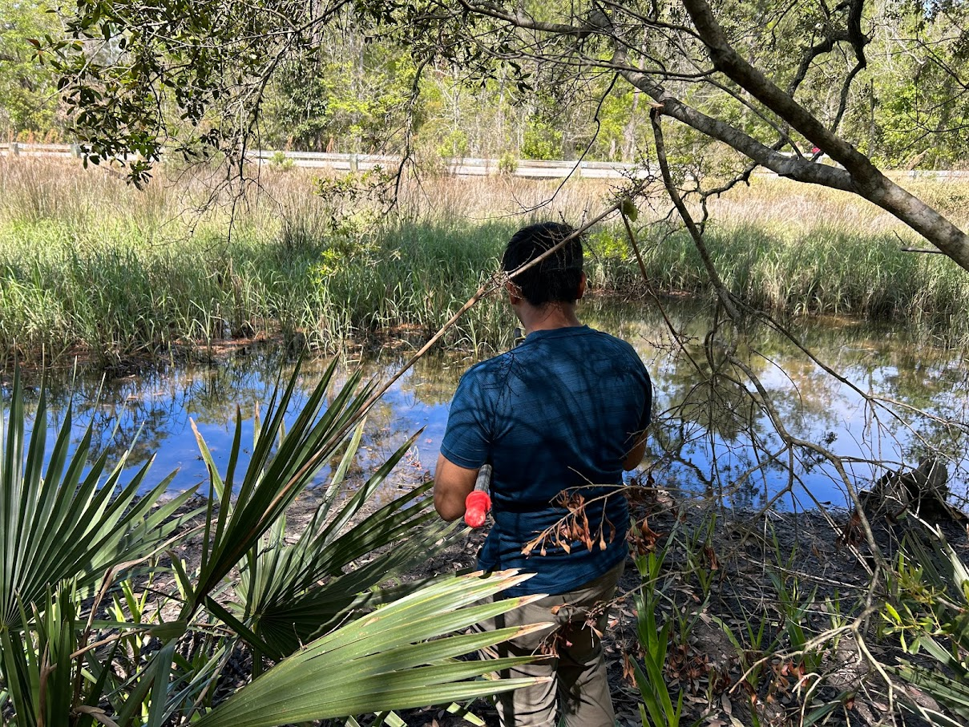
Sampling public land
Notes:
Site 3: Davis Bayou Area gulf Islands National Seashore, Old Shell Landing Road
Date: 3/22/2023
Total number of samples: 64

Slide 29
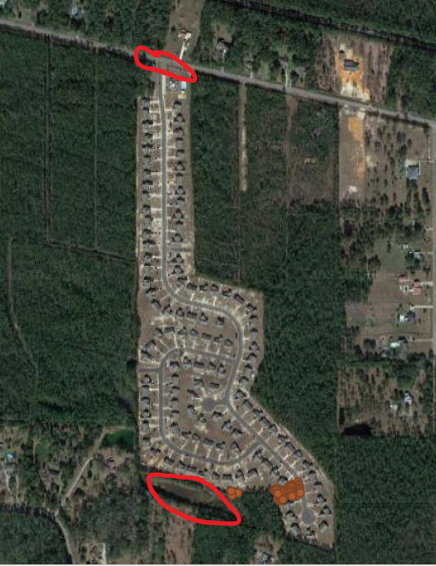
Retention pond
Notes:
Looks at gps before – identified retention ponds front and back of subdision

Slide 30
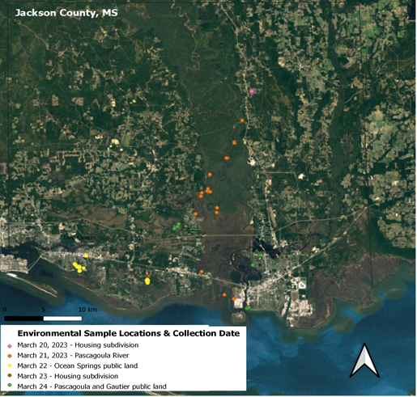

Slide 31
Next Steps
Targeted studies looking at wide variety of research questions (metagenomics, concentration, etc.)
Implementing large scale surveillance (environmental, animal, serological, etc.)
Notes:
We received remnant serum samples from a commercial laboratory covering the 6 counties of the MS Gulf Coast to look at seroprevalence in the area – the testing for that is ongoing. We are also collaborating with a university (NAU) to do further environmental testing in the area – they are in the process of collecting and testing those samples.
I’d also like to highlight partnership we already have with MSU that we hope to continue to build. Dr Erick Sparks in the MSU Coastal Extension Program and his team were a huge help during the second round of sampling in MS in 2023 (he even provided the boat!). We have been talking to Dr Holley Muraco in MSU’s Coastal One Health Program about potential collaborations with her work in the local stranding program. Holley is hoping to incorporate meliodosis testing on stranded marine mammal samples they receive in the future.

Slide 32
Severe inhalation anthrax-like illness from B. tropicus containing the pXO1 plasmid in a welder — Mississippi and Louisiana, 2020
32
Notes:
By way of background, I’m going to speak for a few minutes about
bacterial classification for the Bacillus cereus Group, normal resistance patterns for these bacteria
then I’ll talk about the special susceptibility that welders appear to have to infections from this organism,
Devote a couple of slides to leukemoid reactions
And provide some info about the monoclonal antitoxin raxibacumab and about serious adverse events that have been noted with other antitoxins

Slide 33
On May 1st, 2020, the Mississippi LRN notified BSPB about a human Bacillus sp. isolate that was positive on one of the B. anthracis PCR targets
B. anthracis PCR targets
BA1 | BA2 | BA3
pXO1 plasmid
anthrax toxin genes
Notes:
On May 1st, 2020, the Mississippi LRN notified the Bacterial Special Pathogens Branch about a human Bacillus species isolate from a critically ill ICU patient that was positive on one of the B. anthracis real-time PCR targets.
It was positive for the pXO1 plasmid, but negative for pXO2 and the chromosome, indicating it was not B. anthracis.
The pXO1 genes encode the anthrax toxins: the protective antigen, lethal factor, and edema factor.

Slide 34
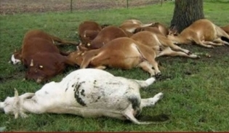
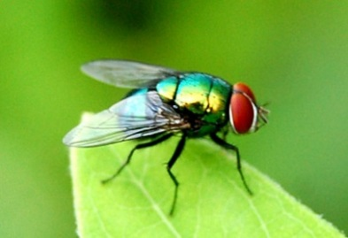
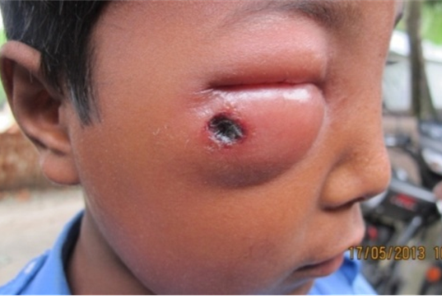
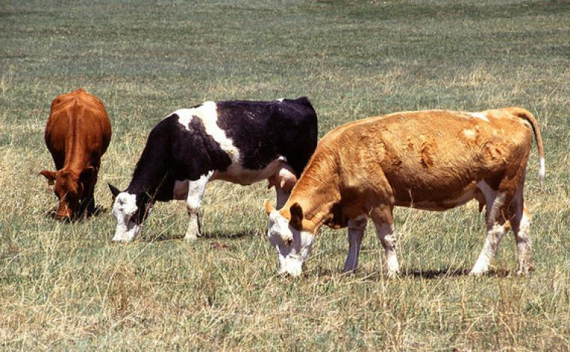
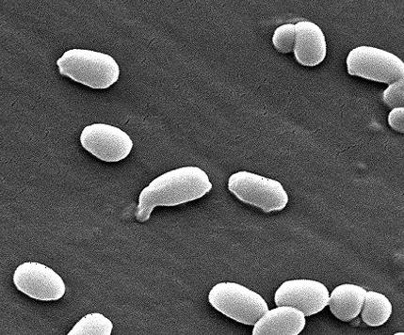
Cycle of B. anthracis Infection
Notes:
Here is a brief overview of the cycle of anthrax infection.
Herbivores ingest spores when grazing or browsing vegetation or drinking contaminated water. The incubation period in livestock is typically 3 to 7 days, but can range from 1 to 14 days.
Infection results in rapid death with massive terminal bacteremia. Vegetative bacilli are shed in blood and discharges or when scavengers open carcasses exposing vegetative cells to the environment. Sporulation occurs when bacilli are released into nutrient depleted environments.
Certain soil conditions favor spore survival, such as a pH > 6.0, and high calcium, moisture, and high organic matter content. Rain concentrates spore-containing soil into low-lying areas and surface waters. Spores are also hydrophobic and can float from groundwater to soil surfaces. Spores cling to roots and vegetation where they are ingested by grazing animals starting the cycle again.
Biting flies may serve as mechanical vectors.
Humans are secondary infected by coming in contact with infected animals or consuming infected meat.

Slide 35
There are only 6 previously known cases of inhalation anthrax-like illness associated with a B. cereus-like organism hosting pXO1.
# | Paper | Year | Location | Occupation | Outcome
1 | Hoffmaster et al. | 1994 | LA | Welder | Survived
2 | Miller et al | 1996 | LA | Welder | Died
3 | Hoffmaster et al. | 2003 | TX | Welder | Died
4 | Hoffmaster et al. | 2003 | TX | Muller | Died
5 | Pena-Gonzalez et al. | 2007 | LA | Welder | Died
6 | Wright et al. | 2011 | TX | Welder | Died
Notes:
There are only 6 previously known cases of inhalation anthrax-like illness associated with a B. cereus-like organism hosting pXO1, ranging from 1994 to 2011.

Slide 36
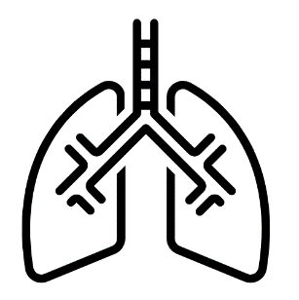




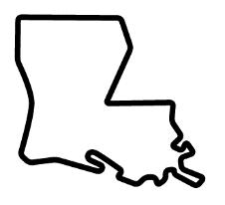

What is the connection between these rare infections and welding?
Notes:
Although there appears to be a strong connection to welding, little is known about how welders become exposed to this bacteria, which we believe is found naturally in soil and dust, and what role their host factors play.
Is there a contaminated product used during welding or metalworking?
Do the equipment used generate excessive dust clouds, which can kick up these bacteria naturally residing in the soil?
Does long-term exposure to fumes from welding and metal grinding make workers particularly susceptible to B. tropicus with pXO1?
And lastly, why are the only known cases from Texas and Louisiana – is there a difference in the type of welding operations in the Gulf coast states, or is that simply part of the natural geographic range of these bacteria?

Slide 37
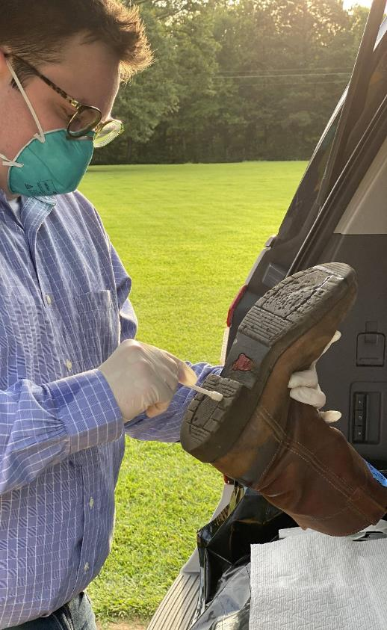
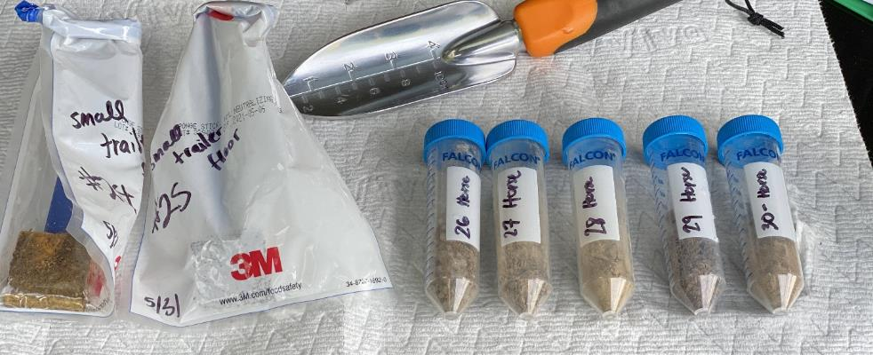
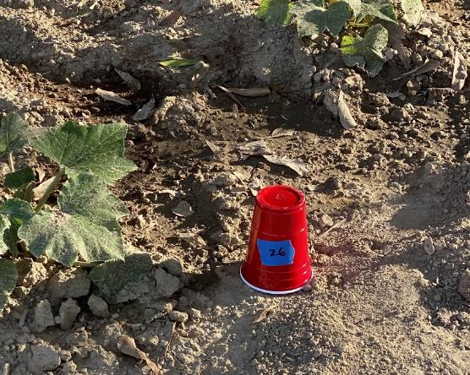
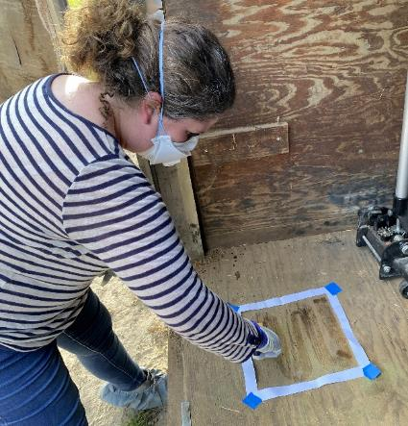
EPI-AID MS and LA, 2020
Notes:
In Mississippi, we collected 35 environmental samples around the patient’s home, including soil samples from the vegetable garden he planted and soil and swabs of the storage trailer and the lumber that was removed from it. Additionally, we collected 18 samples from items connected to his work, including his work boots, two pairs of jeans, a lunch cooler, and the floorboards of his truck.

Slide 38

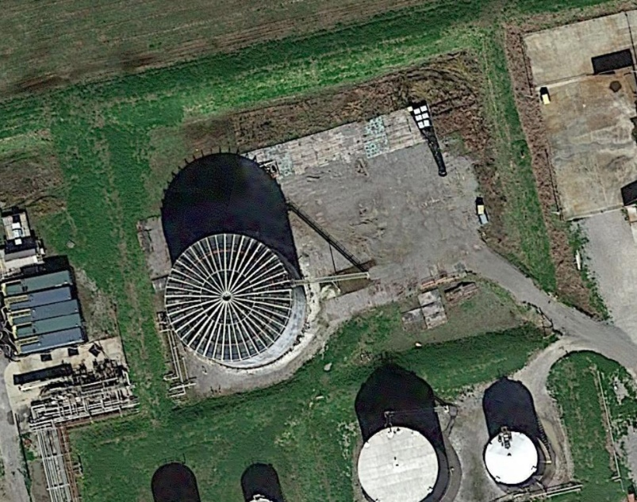
Worksite overview
*Image from Google Maps, 2020
Notes:
As these worksite samples will later become a major piece to the investigation, I will provide a brief overview of our sampling scheme. Here is a satellite image of the oil tank site where the patient worked as a welder.

Slide 39
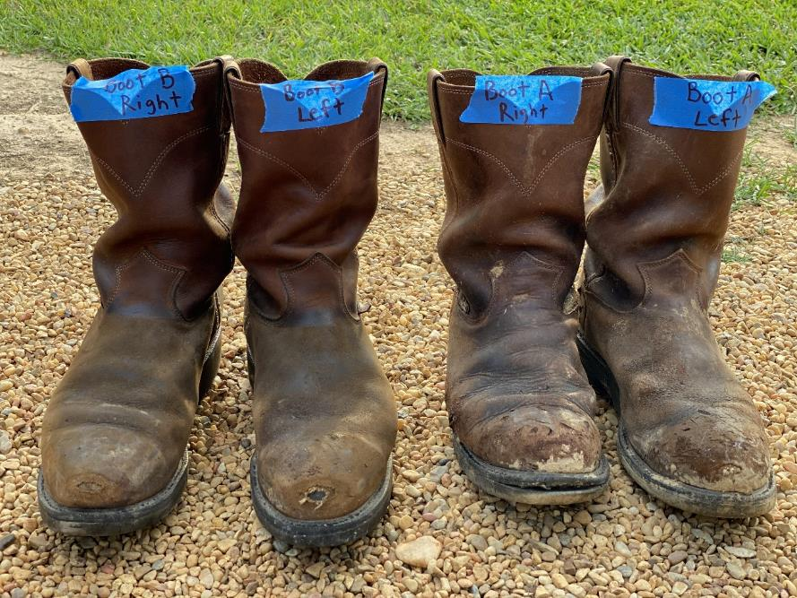
All samples were tested and 14 were RT-PCR positive – all from the worksite or work-related items.
+
+
Worksite in Louisiana (n=132):
010 Positive 04 Inconclusive
118 Negative
Work-related items in Mississippi (n=18):
004 Positive 00 Inconclusive
014 Negative
Patient’s home in Mississippi (n=35):
000 Positive 00 Inconclusive
035 Negative
+
+
+
+
?
–
?
–
–
+
?
+
Notes:
All samples have been tested and 14 were PCR-positive, all from the worksite in Louisiana or work-related clothing and gear the patient had at home. Additionally, 4 worksite samples were inconclusive as only the first extraction was positive. Let’s take a look at where the positive and inconclusive samples were collected.

Slide 40
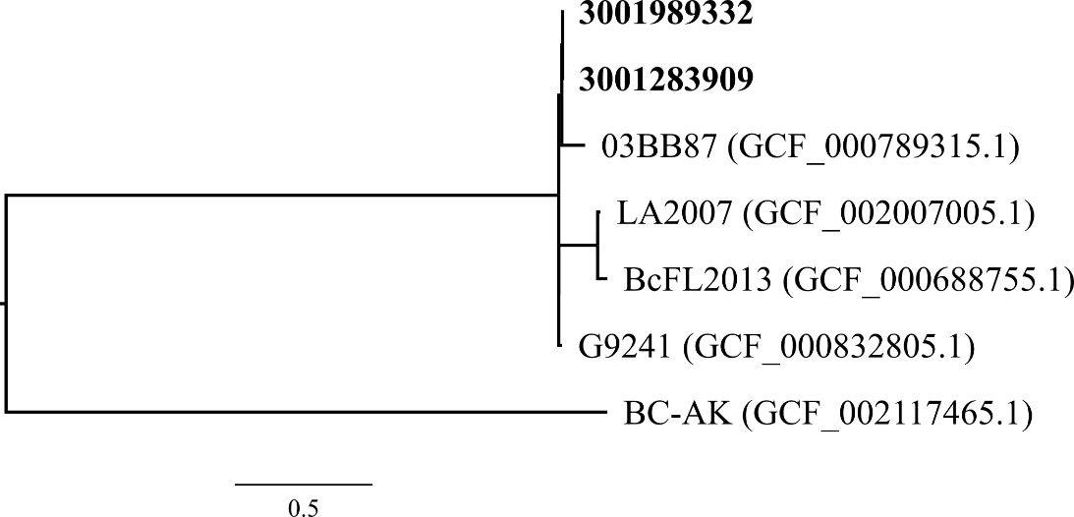
One of the PCR-positive samples has been cultured and it is a genetic match to the patient’s isolate.
patient isolate
Includes all ST-78 genomes
worksite isolate
80% core alignment
*Slide courtesy of Christopher Gulvik/ZSAL
Notes:
One of the PCR-positive samples collected in front of the oil tank access door has been successfully cultured, and it is a genetic match to the patient’s isolate. Looking at the SNP phylogeny, the two isolates are clonal.

Slide 41

Unanswered questions
What is the geographic range of B. tropicus with pXO1?
Are others besides welders at risk for infection?
What specific host factors put welders at greatest risk?
What prevention strategies would be most effective in preventing future cases among high-risk individuals?
Notes:
This investigation has raised a number of epidemiologic and clinical questions that have yet to be answered, but could be addressed through ecological niche modeling, observational studies, continued surveillance, and thorough investigations of future cases.
Some of these questions include: What is the geographic range of B. tropicus with pXO1? Are others besides welders at risk for infection? What specific host factors put welders at greatest risk? What prevention strategies would be most effective in preventing future cases among high-risk individuals?

Slide 42
Questions?

Slide 43
Addition slides
43
Notes:
By way of background, I’m going to speak for a few minutes about
bacterial classification for the Bacillus cereus Group, normal resistance patterns for these bacteria
then I’ll talk about the special susceptibility that welders appear to have to infections from this organism,
Devote a couple of slides to leukemoid reactions
And provide some info about the monoclonal antitoxin raxibacumab and about serious adverse events that have been noted with other antitoxins

Slide 44
All environmental and product samples were tested at CDC for B. pseudomallei
Enrichment
(in Galimand’s broth for 6 days)
DNA Extraction
(EZ1 instrument)
Culture
(Ashdown’s agar)
PCR
(TTS)
PCR
(TTS)
InBios Lateral Flow
Notes:
All samples they were tested at CDC for B. pseudomallei by enrichment followed by PCR and culture

Slide 45
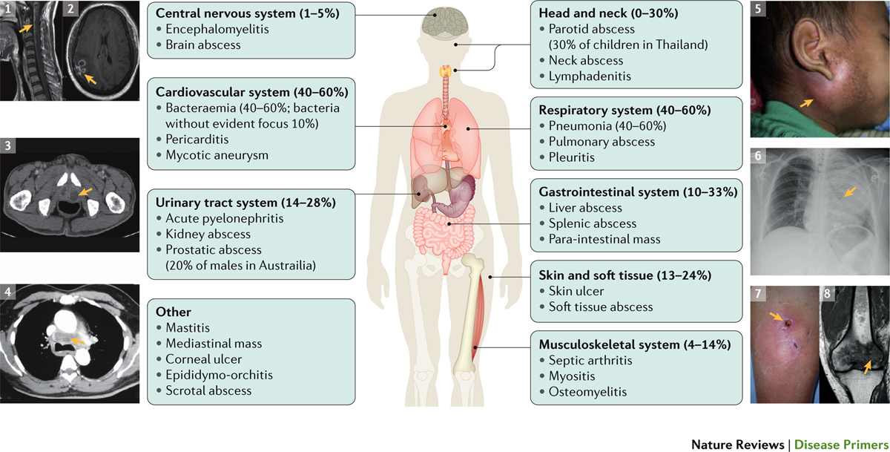
Melioidosis is known as the “Great Mimicker”
Notes:
Although pneumonia is the most common clinical presentation in adult patients, melioidosis can infect any organ of the body. Clinical manifestations vary widely from acute sepsis and pneumonia to chronic infection – to localize skin infection – to organ abscess to encephalomyelitis….with case fatality rates ranging from 10-50%. It has been dubbed as the “great mimicker” of diseases as I can look like many other diseases, it most often is mistaken for TB.

